Slide 1
Chapter 2:
Data Manipulation

Slide 2
Chapter 2: Data Manipulation
2.1 Computer Architecture
2.2 Machine Language
2.3 Program Execution
2.4 Arithmetic/Logic Instructions
2.5 Communicating with Other Devices
2.6 Other Architectures

Slide 3
Computer Architecture
Central Processing Unit (CPU) or processor
  Arithmetic/Logic unit versus Control unit
  Registers
    General purpose
    Special purpose
Bus
Motherboard

Slide 4
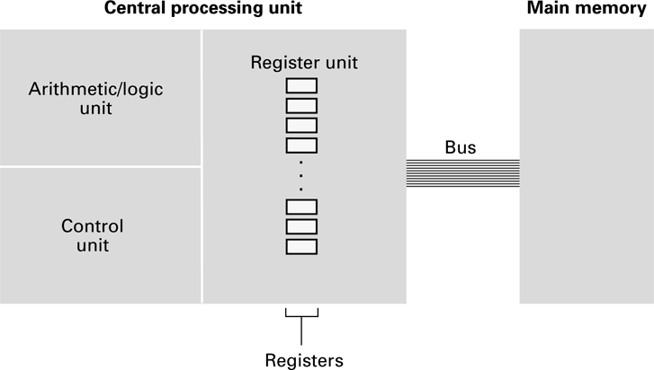
Figure 2.1 CPU and main memory connected via a bus

Slide 5
Stored Program Concept
A program can be encoded as bit patterns and stored in main memory. From there, the CPU can then extract the instructions and execute them. In turn, the program to be executed can be altered easily.

Slide 6
Terminology
Machine instruction: An instruction (or command) encoded as a bit pattern recognizable by the CPU
Machine language: The set of all instructions recognized by a machine

Slide 7
Machine Language Philosophies
Reduced Instruction Set Computing (RISC)
  Few, simple, efficient, and fast instructions
  Examples: PowerPC from Apple/IBM/Motorola
  and SPARK from Sun Microsystems
Complex Instruction Set Computing (CISC)
  Many, convenient, and powerful instructions
  Example: Pentium from Intel

Slide 8
Machine Instruction Types
Data Transfer: copy data from one location to another
Arithmetic/Logic: use existing bit patterns to compute a new bit patterns
Control: direct the execution of the program

Slide 9
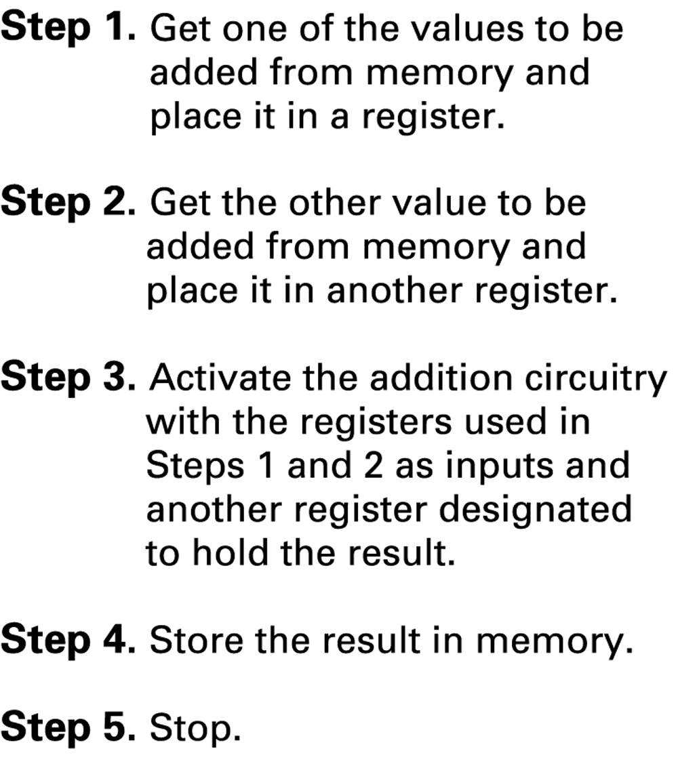
Figure 2.2 Adding values stored in memory

Slide 10
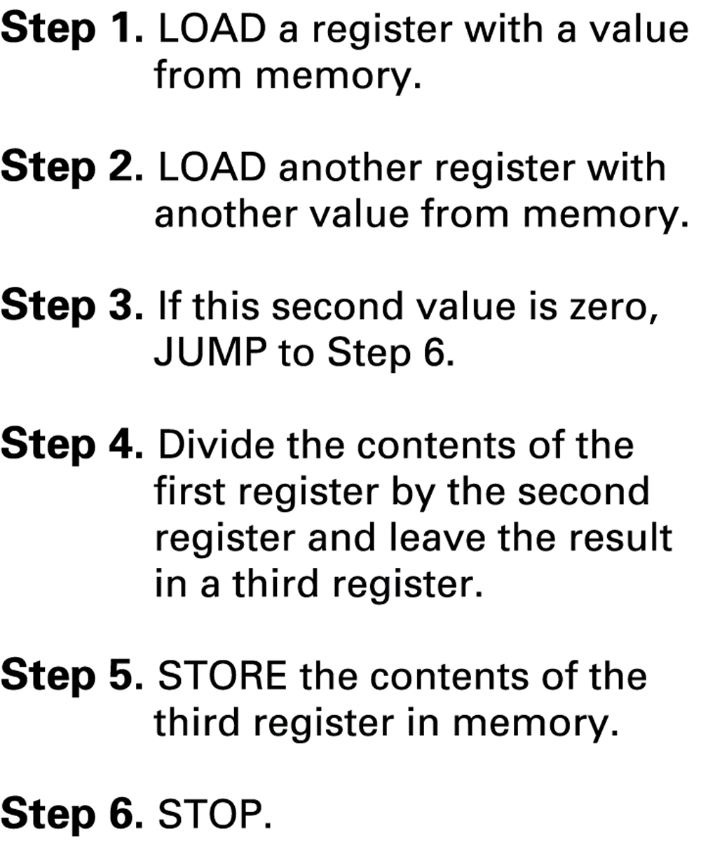
Figure 2.3 Dividing values stored in memory

Slide 11
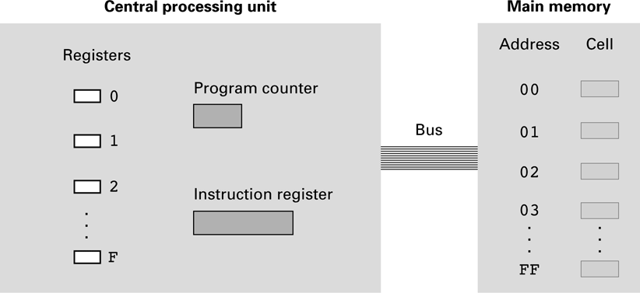
Figure 2.4 The architecture of the machine described in Appendix C

Slide 12
Parts of a Machine Instruction
Op-code: Specifies which operation to execute
Operand: Gives more detailed information about the operation
  Interpretation of operand varies depending on op-code

Slide 13
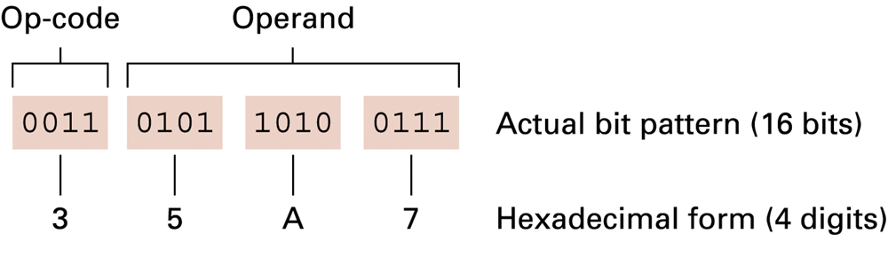
Figure 2.5 The composition of an instruction for the machine in Appendix C

Slide 14
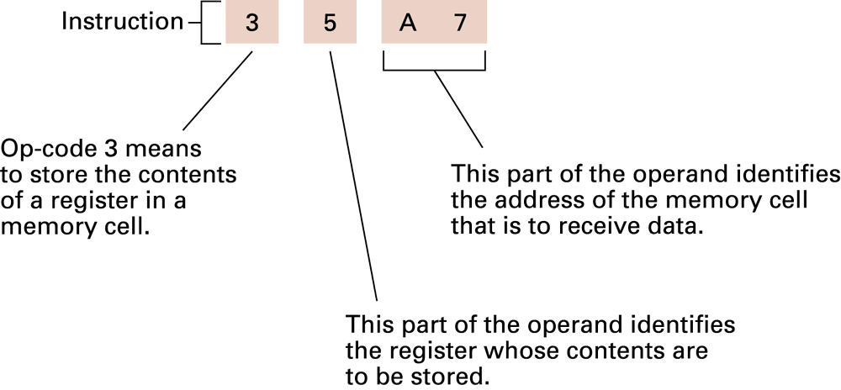
Figure 2.6 Decoding the instruction 35A7

Slide 15
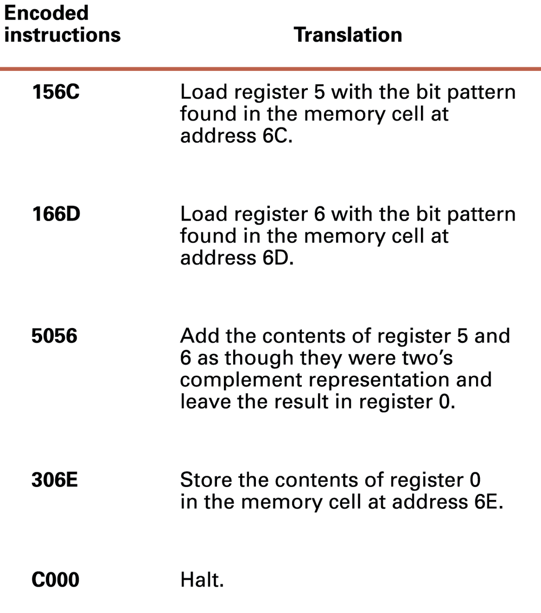
Figure 2.7 An encoded version of the instructions in Figure 2.2

Slide 16
Program Execution
Controlled by two special-purpose registers
  Program counter: address of next instruction
  Instruction register: current instruction
Machine Cycle
  Fetch
  Decode
  Execute

Slide 17
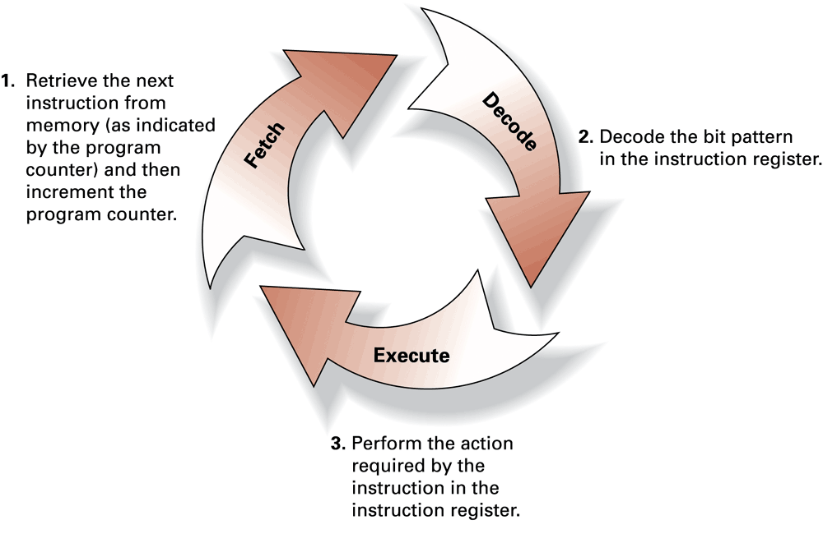
Figure 2.8 The machine cycle

Slide 18
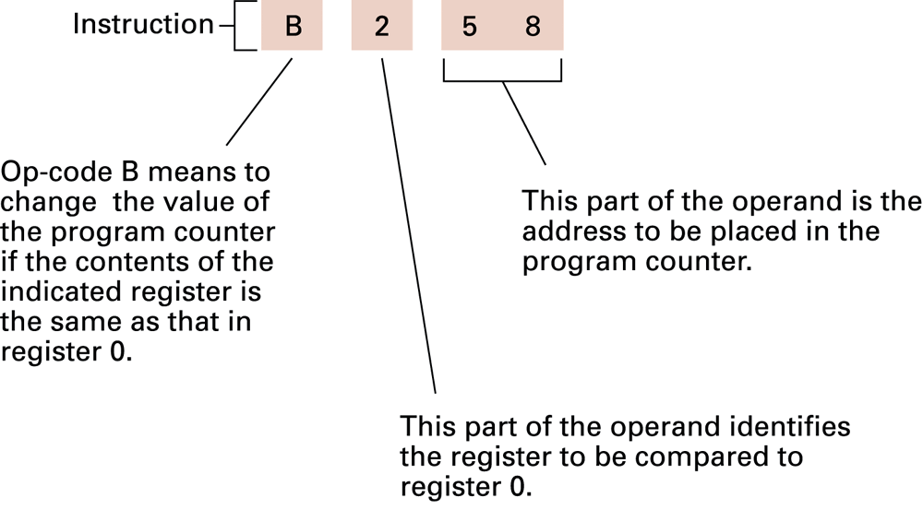
Figure 2.9 Decoding the instruction B258

Slide 19
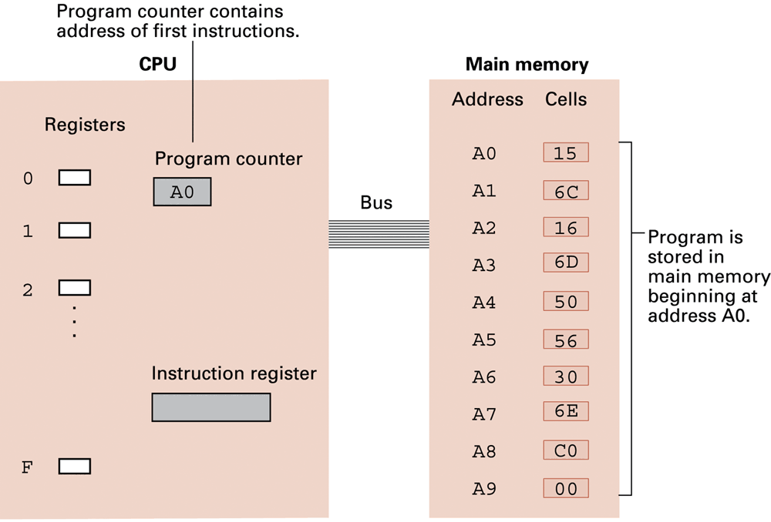
Figure 2.10 The program from Figure 2.7 stored in main memory ready for execution

Slide 20
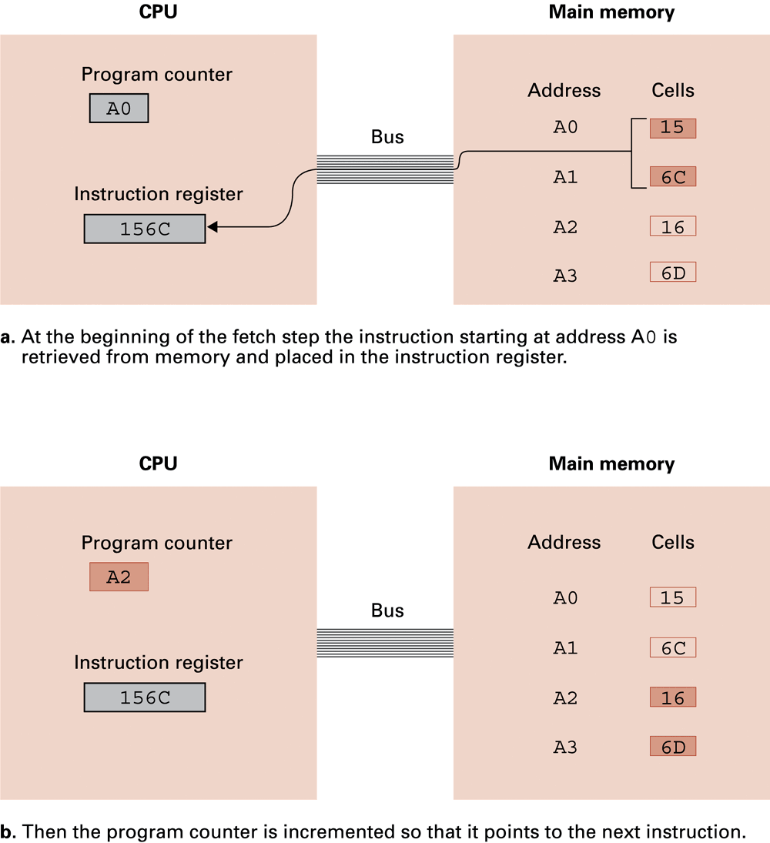
Figure 2.11 Performing the fetch step of the machine cycle

Slide 21
Figure 2.11 Performing the fetch step of the machine cycle (cont’d)

Slide 22
Arithmetic/Logic Operations
Logic: AND, OR, XOR
  Masking
Rotate and Shift: circular shift, logical shift, arithmetic shift
Arithmetic: add, subtract, multiply, divide
  Precise action depends on how the values are encoded (two’s complement versus floating-point).

Slide 23
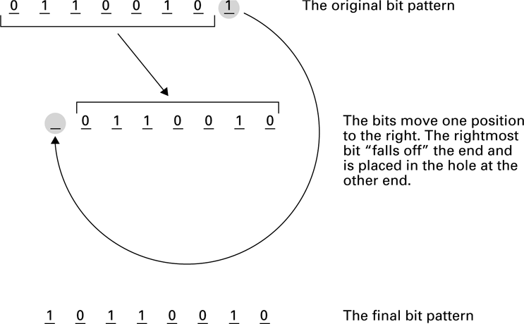
Figure 2.12 Rotating the bit pattern 65 (hexadecimal) one bit to the right

Slide 24
Communicating with Other Devices
Controller: An intermediary apparatus that handles communication between the computer and a device
  Specialized controllers for each type of device
  General purpose controllers (USB and FireWire)
Port: The point at which a device connects to a computer
Memory-mapped I/O: CPU communicates with peripheral devices as though they were memory cells

Slide 25
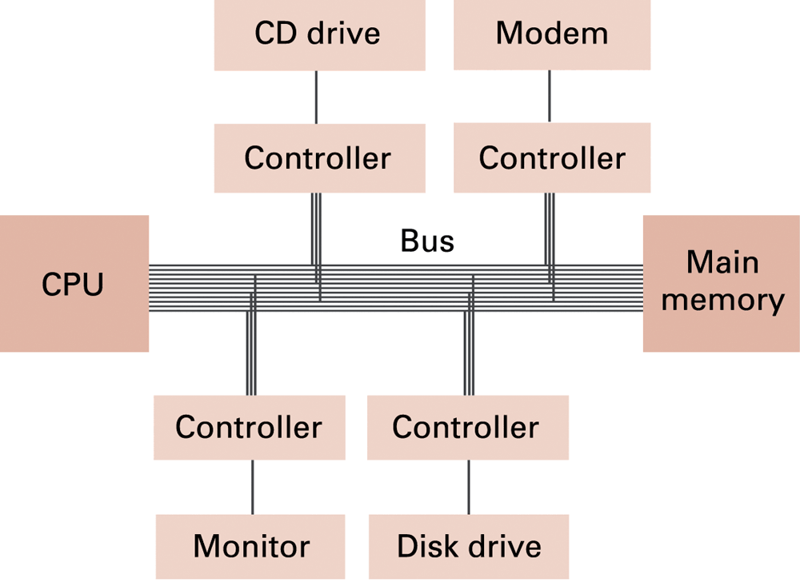
Figure 2.13 Controllers attached to a machine’s bus

Slide 26
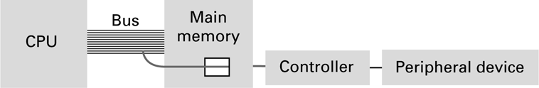
Figure 2.14 A conceptual representation of memory-mapped I/O

Slide 27
Communicating with Other Devices (continued)
Direct memory access (DMA): Main memory access by a controller over the bus
Von Neumann Bottleneck: Insufficient bus speed impedes performance
Handshaking: The process of coordinating the transfer of data between components

Slide 28
Communicating with Other Devices (continued)
Parallel Communication: Several communication paths transfer bits simultaneously.
Serial Communication: Bits are transferred one after the other over a single communication path.

Slide 29
Data Communication Rates
Measurement units
  Bps: Bits per second
  Kbps: Kilo-bps (1,000 bps)
  Mbps: Mega-bps (1,000,000 bps)
  Gbps: Giga-bps (1,000,000,000 bps)
Bandwidth: Maximum available rate

Slide 30
Other Architectures
Technologies to increase throughput:
  Pipelining: Overlap steps of the machine cycle
  Parallel Processing: Use multiple processors simultaneously
    SISD: No parallel processing
    MIMD: Different programs, different data
    SIMD: Same program, different data

